Slide 1
Chapter 11 CHI SQUARE TEST OF INDEPENDENCE/ASSOCIATION

Slide 2
The Chi-Square Test
Inferential statistical technique to test for significant relationships between two nominal or ordinal variables
Widely used in social sciences
Requires no assumptions about the shape of the population distribution from which a sample is drawn

Slide 3
Statistical Independence
Tests the independence of (absence of association between) two variables

Slide 4
Hypothesis Testing with Chi-Square
Making assumptions
Stating the research and null hypotheses and selecting alpha
Selecting the sampling distribution and specifying the test statistic
Computing the test statistic
Making a decision and interpreting the results

Slide 5
Assumptions
Requires no assumptions about the shape of the population distribution from which the sample was drawn
Like all inferential techniques, it assumes random sampling
It can be applied to variables at a nominal and/or an ordinal level of measurement

Slide 6
Stating the Hypotheses
The research hypothesis (H1)
Proposes that the two variables are related in the population
The null hypothesis (H0)
States that no association exists between the two cross-tabulated variables in the population, therefore the variables are statistically independent

Slide 7
The Concept of Expected Frequencies
Expected frequencies (f_{e})
Cell frequencies if the two variables were statistically independent
Observed frequencies (f_{o})
Cell frequencies actually observed in a bivariate table

Slide 8
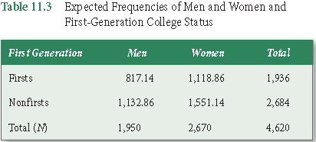

Calculating the Expected Frequencies

Slide 9
Calculating the Obtained Chi-Square
Chi-Square (obtained)
The test statistic that summarizes the differences between the observed and the expected frequencies
By calculating the difference for each cell

Slide 10
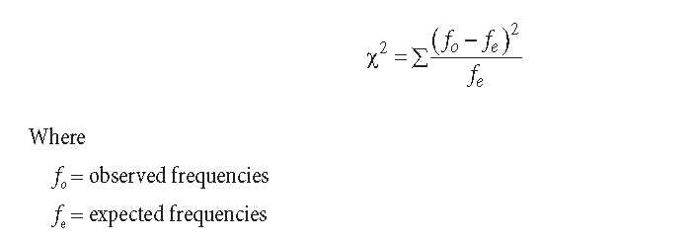
Calculating the Obtained Chi-Square

Slide 11
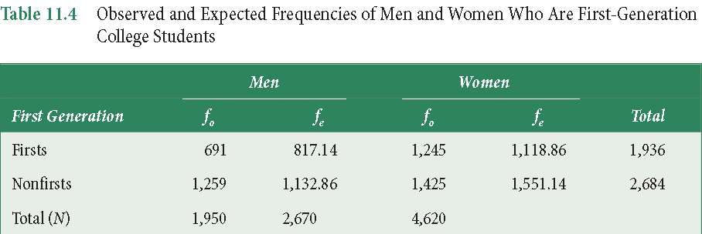
Calculating Chi-Square

Slide 12
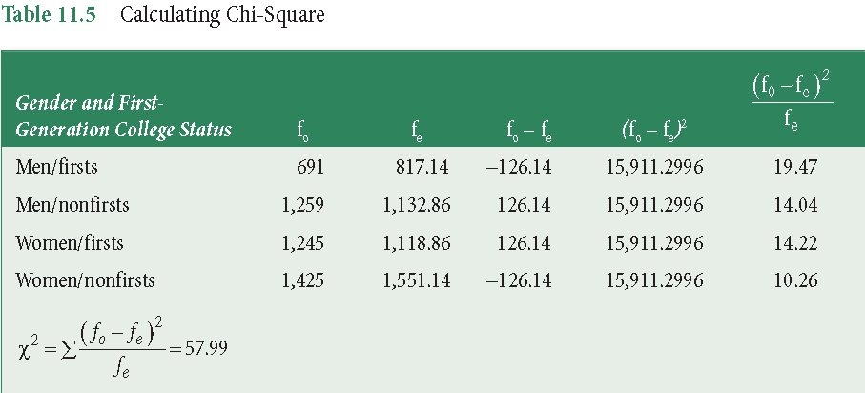
Calculating Chi-Square

Slide 13
Calculating Chi-Square
Next, we use our obtained Chi-Square (X²), and our degrees of freedom (df) and look up the significance level in Appendix D (p 486).
Using our df, we follow the table down that row and stop when we reach a value greater than our obtained X². Then go back one column.
If there is no value greater than your obtained value, use the final column.
Go up to that column, and report that value as your p-value (significance level).

Slide 14
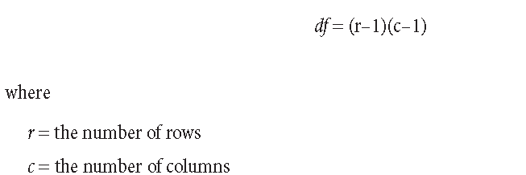
Degrees of Freedom

Slide 15
Calculating Chi-Square
In our example, we have the following:
X² = 57.99
df = (2-1)(2-1) = 1
In our Appendix D, we follow the df = 1 row, down to find a value greater than 57.99.
There isn’t, which means that our p-value (our likelihood of being wrong) is less than .001 (less than .1 percent).
p < .001

Slide 16
Reporting Chi Square
Report
The test used
If you reject or fail to reject the null hypothesis
The variables used in the analysis
The degrees of freedom, calculated value of the test, and p-value
X²(df) = Chi-square value, p-value
“Using the Chi Square test of independence, I reject the null hypothesis that there is no relationship between gender and immigration status, X²(1) = 57.99, p < .001”

Slide 17
Chi-Square
The Sampling Distribution
The distributions are positively skewed
The research hypothesis is always a one-tailed test
Values are always positive
Minimum is zero with no maximum
As the number of degrees of freedom increases, the chi-square distribution becomes more symmetrical

Slide 18
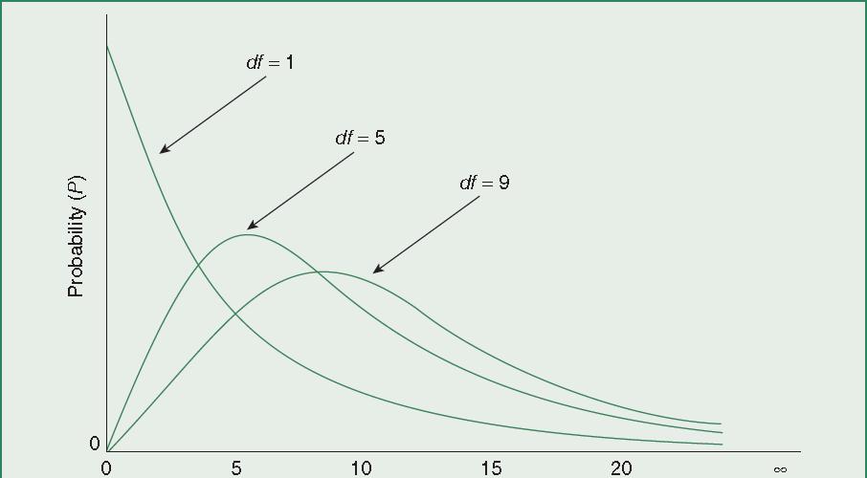
Chi-Square Distributions

Slide 19
Chi-Square Test Limitations
Does not offer much information about the strength of the relationship
Sensitive to sample size
Sensitive to small expected frequencies in one or more of the cells in the table

Slide 20
Key Terms
Chi-square (obtained)
Chi-square test
Expected frequencies
Observed frequencies
Statistical independence
Asymmetrical measure
of association
Gamma
Kendall’s tau-b
Lambda

Slide 21
Key Terms
Measure of association
Proportional reduction of error
Symmetrical measure of association

